Slide 1
AEM 2210
Financial Accounting
Chapter 03: Operating Decisions and the Accounting System
Professor Sinclair
Spring 2018

Slide 2
Chapter 03 Learning Objectives
Describe a typical business operating cycle and explain the necessity for the time period assumption
Explain how business activities affect the elements of the income statement
Explain the accrual basis of accounting and apply the revenue and expense recognition principles to measure income
Apply transaction analysis to examine and record the effects of operating activities on the financial statements
Prepare a classified income statement
Compute and interpret the net profit margin ratio

Slide 3
The Operating Cycle
The operating cycle begins with the purchase or manufacture of a product for sale. When products are purchased from suppliers, those suppliers must be paid. After a sale has been made, the company must deliver the product or service to the customer. Many business sales are made on credit. If credit is extended, payment must be received from customers. Once the cash has been collected from customers, the business cycle begins all over again.
We never want to confuse the business operating cycle with the accounting cycle.
Companies (1) acquire inventory and the services of employees and (2) sell inventory or services to customers. The operating (or cash-to-cash) cycle begins when a company receives goods to sell (or, in the case of a service company, has employees work) and ends when customers pay cash to the company. The length of time for completion of the operating cycle depends on the nature of the business.

Slide 4
The Cash Conversion Cycle
How many days does it take a company to pay for and generate cash from the sales of its inventory?
Often a company will finance its inventory instead of paying for it with cash up front. This means they owe someone money which generates “Accounts Payable”. Many times they will turn around and sell that inventory on credit without getting all the cash at the time of the sale. This means people owe them money and generates “Accounts Receivable”.
The formula for the Cash Conversion Cycle is:
Days of Sales Outstanding (DSO) + Days of Inventory Outstanding (DIO) - Days of Payables Outstanding (DPO)
Cash Conversion Cycle (CCC)
The entire CCC is often referred to as the Net Operating Cycle. It is “net” because it subtracts the number of days of Payables the company has outstanding from the Operating Cycle. The logic behind this is that Payables are really viewed as a source of operating cash or working capital for the company. By contrast, Receivables, or cash the company has not received yet, decreases working capital available to the company to finance operations.

Slide 5
The Cash Conversion Cycle
Days of Sales Outstanding
DSO tells you how many days after the sale it takes people to pay you on average. You want to get paid by your customers quickly, so a lower number is better but as always this needs to be taken in context. You don’t want to make your customers pay so quickly that they buy from someone else with less aggressive collection policies.
Whenever we use ratios that mix Balance Sheet numbers (Accounts Receivable) with Income Statement numbers (Revenue) we should average the Balance Sheet numbers from the beginning and end of the period. This is because the Income Statement measures activity that takes place over the entire period, whereas a Balance Sheet is the valuation of the various accounts on a particular day (usually the end of the period).
Average A/R
Revenue per Day
DSO
=

Slide 6
The Cash Conversion Cycle
Days Inventory Outstanding
DIO, sometimes referred to Days of Inventory on Hand and abbreviated DOH (think Homer Simpson), tells you how many days inventory sits on the shelf on average. For the most part, you want to see your inventory flying off the shelves, so again a lower number is better, but not so low that you don’t have sufficient inventory and are missing potential sales.
Days Inventory Outstanding, or DIO, is similar to DSO but instead of comparing Sales per day relative to average Receivables, it looks at Cost of Goods Sold per day relative to average Inventory levels.
Average Inventory
COGS per Day
DIO
=

Slide 7
The Cash Conversion Cycle
Operating Cycle
The first two components of the CCC, DSO plus DIO are what is called the Operating Cycle. This is how many days it takes for a company to process raw material and/or inventory and collect cash from the sale.
Operating Cycle = DSO + DIO
Basically the Operating Cycle tells you how many days it takes for something to go from first being in inventory to receiving the cash after the sale. You want this number to be low meaning that merchandise isn’t sitting on shelves too long and customers are paying relatively quickly.

Slide 8
The Cash Conversion Cycle
Days of Payables Outstanding
Days of Payables Outstanding tells you how many days the company takes to pay its suppliers. Unlike the other two numbers that make up the Operating Cycle, the company wants to stretch out how long it takes to pay for its inventory. In reality, it is a form of free vendor financing. However, the company wouldn’t want to take so long to pay that it misses out on big discounts for paying early or incentives offered if there are any.
Days of Payables Outstanding ,or DPO, is the final component of the Net Operating Cycle and it gets subtracted from the Operating Cycle (hence the “net”). It measures the number of days of Accounts Payable the company has outstanding relative to their purchases of inventory or COGS.
Average A/P
COGS per Day
DPO
=

Slide 9
The Operating Cycle and Cash Conversion Cycle
Raw materials purchased
Inventory Sold
Cash received
Order placed
Stock Arrives
Days in Inventory (including production)
Days Sales Outstanding
Average Days in Accounts Payable
Time
Average Days in Accounts Receivable
Payment Delay
Firm receives invoice
Cash paid for raw materials
Expected payment date
Cash Conversion Cycle
Operating Cycle

Slide 10


The Operating Cycle and Cash Conversion Cycle
(2016 figures; in millions USD)
Revenue | 135,987 | 25,778
COGS | 88,265 | 15,621
Average A/R | 6,997 | 540
Average Inventory | 10,852 | 5,453
Average A/P | 22,853 | 1,475
DSO | 18.77 | 7.64
DIO | 44.88 | 127.40
DPO | 94.50 | 34.45
Operating Cycle | 63.66 | 135.05
Cash Conversion Cycle | -30.85 | 100.59
This is incredible! Amazon has a NEGATIVE cash conversion cycle. That basically means they are getting paid by their customers long before they pay their suppliers. Essentially this is an interest free way to finance their operations by borrowing from their suppliers.
They both take over one month to pay Accounts Payable and Macy’s gets paid by customers very quickly, mainly because people pay cash or use credit cards. The big difference is inventory management. Not surprisingly things sit on Macy’s shelves longer than Amazon’s. They hold inventory for on average about 45 days. Granted, Macy’s business model is very different from Amazon’s, but still, a negative cash conversion cycle is quite impressive!

Slide 11
The Operating Cycle
Time period assumption: The long life of a company can be reported over a series of shorter time periods.
We know that most successful companies operate for a very long period of time, and managers and investors need financial information on a timely basis. For accountants to provide this information, we have to divide the life of the business into relatively short, arbitrary time periods. We usually divide the life of a business into months, quarters, and annual time periods. When we establish these relatively short time periods, we create many measurement issues—for example, problems of revenue and expense recognition.
Two issues arise when reporting periodic income:
Recognition issues: When should the effects of operating activities be recognized (recorded)?
Measurement issues: What amounts should be recognized?

Slide 12
Income Statement

Slide 13
Income Statement
The income statement contains revenues, expenses, gains, and losses.
Operating Revenues result from the sale of goods or services. When revenue is earned, assets, usually Cash or Accounts Receivables, often increase. Sometimes if a customer pays for goods or services in advance, a liability account, usually Unearned (or Deferred) Revenue, is created.
Expenses are decreases in assets or increases in liabilities from ongoing operations incurred to generate revenues during the period.
Gains result in an increase in assets or decrease in liabilities from a peripheral transaction.
Losses are decreases in assets or increases in liabilities from peripheral transactions.

Slide 14
Operating Revenues
Operations of the business: the sale of goods or rendering of services as the central focus of the business
e.g., When Barnes & Noble sells books, it has earned revenue.
Revenues
Any increases in assets or settlements of liabilities from ongoing operations of the business
NOTE: Sometimes, a customer can pay for goods or services in advance. This results in a cash transaction but no services being rendered or goods being sold. We would define this transaction as unearned revenue, which is a liability account, because the cash was received, but we have not earned the revenue yet by performing the service or selling the goods.

Slide 15
Operating Expenses
An expenditure is any outflow of cash for any purpose, whether to buy equipment, pay off a bank loan, or pay employees their wages.
Operating expenses are outflows, or the using up of assets, or increases in liabilities from ongoing operations incurred to generate revenues during the period. Therefore, not all cash expenditures are expenses, but expenses are necessary to generate revenues.
Examples of expenses incurred by a restaurant include:
Food, Beverage, and Packaging Expense
Salaries and Wages Expense
Occupancy Expense
Other Operating Expenses
General and Administrative Expenses
Utilities and Supplies Expense
Advertising Expense
Insurance Expense
Depreciation Expense
Income Tax Expense
Operating revenues less operating expenses equals operating income. This is a measure of profit from the ongoing activities of the organization.

Slide 16
Other Income Statement Items
Not all activities affecting an income statement are central to ongoing operations. These are examples of other income statement items, which are not included with operating income:
Interest revenue
Interest expense
Gain or loss on sale of investments
Income tax expense
Corporations are required to disclose earnings per share (EPS). This is typically presented at the bottom of the income statement.

Slide 17
Cash Basis
v.
Accrual Basis

Slide 18
Cash Basis v. Accrual Basis
Companies that use cash basis accounting recognize revenue at the time cash is received and recognize expenses at the time cash is paid. Financial performance is measured as the difference between the cash balance at the beginning of the period and the cash balance at the end of the period. Many local retailers, medical offices, and other small businesses use cash basis accounting.
Cash basis is NOT ALLOWED under GAAP
 | 20X5 | 20X6 | 20X7 | Total
Sales of credit | $60,000 | $60,000 | $60,000 | $180,000
Cash receipts from customers | $20,000 | $70,000 | $90,000 | $180,000
Cash disbursements for:
Salaries | (30,000) | (30,000) | (30,000) | (90,000)
Insurance (prepaid) | (12,000) | ( 0) | ( 0) | (12,000)
Supplies (paid on credit) | ( 3,000) | ( 7,000) | ( 5,000) | (15,000)
Net Operating Cash Flows | (25,000) | 33,000 | 55,000 | 63,000
Performance over time appears uneven

Slide 19
Cash Basis v. Accrual Basis
GAAP require that assets, liabilities, revenues, and expenses be recognized when the transaction that causes them occurs. In accrual basis accounting, revenues and expenses are recognized when the transaction that causes them occurs, not necessarily when cash is received or paid. That is, revenues are recognized when they are earned and expenses when they are incurred.
Accrual basis is REQUIRED under GAAP

Slide 20
Revenue Recognition

Slide 21
Revenue
Revenue is one of the most important financial statement measures to both preparers and users of financial statements.
In DIS’ 2016 10-K, the word “revenue” was mentioned over 250 times!
Revenue is used to measure and assess aspects of an entity’s past financial performance, future prospects, and financial health.
Revenue recognition is one of the accounting topics most scrutinized by investors and regulators.
More than half of accounting scandals that trigger SEC involvement involve incorrect revenue recognition¹
Despite its significance and the increasing globalization of the world’s financial markets, revenue recognition requirements prior to issuance of new guidance in 2014 differed in US Generally Accepted Accounting Principles (US GAAP) from those in International Financial Reporting Standards (IFRS), at times resulting in different accounting for similar transactions.
In May 2014, the FASB (Financial Accounting Standards Board) and IASB (International Accounting Standards Board) issued their converged standard on revenue recognition, which replaces much of the prescriptive and often industry-specific or transaction-specific guidance included in today’s accounting literature.
¹ Dechow, Ge, Larson, and Sloan, 2011. Predicting material accounting misstatements. Contemporary Accounting Research 28(1).

Slide 22
Revenue Defined
Definition from ASC 606-10-20
Revenue: Inflows or other enhancements of assets of an entity or settlements of its liabilities (or a combination of both) from delivering or producing goods, rendering services, or other activities that constitute the entity’s ongoing major or central operations.
Definition from IFRS 15, Appendix A
Revenue: Income arising in the course of an entity’s ordinary activities.
Income: Increases in economic benefits during the accounting period in the form of inflows or enhancements of assets or decreases of liabilities that result in an increase in equity, other than those relating to contributions from equity participants.
The words may be slightly different, but the underlying principle is the same in the two frameworks. Revenue is recognized as a result of an entity satisfying its promise to transfer goods or services in a contract with a customer.

Slide 23
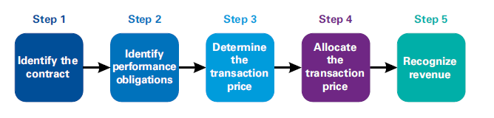
New Revenue Recognition: 5-Step Model
Entities will apply a five-step model to determine when to recognize revenue, and at what amount. The model specifies that revenue is recognized when or as an entity transfers control of goods or services to a customer at the amount to which the entity expects to be entitled. Depending on whether certain criteria are met, revenue is recognized:
Over time, in a manner that best reflects the entity’s performance; or
At a point in time, when control of the goods or services is transferred to the customer

Slide 24
Revenue Recognition
Under the revenue recognition principle, two criteria must normally be met for revenue to be recognized. A company must recognize revenue when it has been both:
Earned
Firm has fulfilled its obligation to the customer (service performed or product delivered)
Realized or Realizable
Firm receives something from customer (cash or a promise to pay)
If cash is received before the company delivers goods or services:
Upon delivery of good or service:
 | Debit | Credit
Cash (+A) | 100
Unearned Revenue (+L) |  | 100
 | Debit | Credit
Unearned Revenue (-L) | 100
Revenue (+R; +SE) |  | 100

Slide 25
Revenue Recognition
Under the revenue recognition principle, two criteria must normally be met for revenue to be recognized. A company must recognize revenue when it has been both:
Earned
Firm has fulfilled its obligation to the customer (service performed or product delivered)
Realized or Realizable
Firm receives something from customer (cash or a promise to pay)
If cash is received on the date the company delivers goods or services:
 | Debit | Credit
Cash (+A) | 100
Revenue (+R; +SE) |  | 100

Slide 26
Revenue Recognition
Under the revenue recognition principle, two criteria must normally be met for revenue to be recognized. A company must recognize revenue when it has been both:
Earned
Firm has fulfilled its obligation to the customer (service performed or product delivered)
Realized or Realizable
Firm receives something from customer (cash or a promise to pay)
If cash is received after the company delivers goods or services:
Upon receipt of cash:
 | Debit | Credit
Accounts Receivable (+A) | 100
Revenue (+R; +SE) |  | 100
 | Debit | Credit
Cash (+A) | 100
Accounts Receivable (-A) |  | 100

Slide 27
Expense Recognition
(Matching Principle)

Slide 28
Expense Recognition
The expense matching principle requires that costs incurred to generate revenues be recognized in the same period; a matching of costs with benefits. For example, when a restaurant provides food service to customers, revenue is earned. The costs of generating the revenue include expenses that are recognized in the same period.
If cash is paid before the expense is incurred to generate revenue:
Upon use of half the prepaid expense (i.e., supplies):
 | Debit | Credit
Prepaid expense (+A) | 100
Cash (-A) |  | 100
 | Debit | Credit
Expense (+E; -SE) | 50
Prepaid expense (-A) |  | 50

Slide 29
Expense Recognition
The expense matching principle requires that costs incurred to generate revenues be recognized in the same period; a matching of costs with benefits. For example, when a restaurant provides food service to customers, revenue is earned. The costs of generating the revenue include expenses that are recognized in the same period.
If cash is paid in the same period the expense is incurred to generate revenue:
 | Debit | Credit
Expense (+E; -SE) | 100
Cash (-A) |  | 100

Slide 30
Expense Recognition
The expense matching principle requires that costs incurred to generate revenues be recognized in the same period; a matching of costs with benefits. For example, when a restaurant provides food service to customers, revenue is earned. The costs of generating the revenue include expenses that are recognized in the same period.
If cash is paid after the expense is incurred to generate revenue:
Upon payment of cash after using expense (i.e., wages):
 | Debit | Credit
Expense (+E; -SE) | 100
Payable (+L) |  | 100
 | Debit | Credit
Payable (-L) | 100
Cash (-A) |  | 100

Slide 31
Managerial Incentives

Slide 32
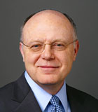
Managerial Incentives: Revenue
Pfizer CEO – Ian Read
2016 Compensation
Salary $ 1,905,250
Incentive $ 4,000,000
Equity $10,316,004
Metrics used to determine incentive compensation:
40% Total Revenue
40% Adjusted diluted earnings per share (EPS)
20% Cash flow from operations

Slide 33

Managerial Incentives: Revenue
BlackRock, Inc. CEO – Laurence Fink
2016 Compensation
Salary $ 900,000
Incentive $ 8,000,000
Equity $16,379,581
Metrics used to determine incentive compensation:
50% Financial Performance (i.e., Net Income, EPS, Total Revenue, Operating Income, Organic Revenue)
30% Business Strength
20% Organizational Strength

Slide 34

Managerial Incentives: Revenue
Delta Air Lines CEO – Edward H. Bastian
2016 Compensation
Salary $ 741,669
Incentive $ 1,512,980
Equity $10,000,437
Metrics used to determine incentive compensation:
50% Financial (pre-tax income)
25% Operational (monthly goals)
25% Revenue

Slide 35
The Importance of Revenue to Managers
Performance measures used in Executives’ annual incentive compensation contracts:
Sample: Executive bonus plan data from S&P 500 firms’ proxy statements (1993-2007)
Source: Huang, Marquardt, and Zhang, 2015. ‘Using sales revenue as a performance metric’ (Table 1 Panel A)

Slide 36
Managerial Incentives to Violate Accounting Rules
Greed may lead some managers to make unethical accounting and reporting decisions, often involving falsifying revenues and expenses. While this sometimes fools people for a short time, it rarely works in the long run and often leads to very bad consequences.
Fraud is a criminal offense for which managers may be sentenced to jail.
Many others are affected by accounting fraud. Shareholders lose stock value, employees may lose their jobs (and pension funds), and customers and suppliers may become wary of dealing with a company operating under the cloud of fraud. As a manager, you may face an ethical dilemma in the workplace. The ethical decision is the one you will be proud of 20 years later.

Slide 37
Form 13F

Slide 38
13F Disclosure
The Securities and Exchange Commission (SEC) mandates that institutional investors, managing over $100 million and using the U.S. mail in the course of business, must report their holdings on Form 13F.
Institutional investors include investment advisers, banks, insurance companies, broker-dealers, pension funds, corporations, and others.
Form 13F is required to be filed within 45 days of the end of a calendar quarter.
The Form 13F report requires the following data elements: the name of the institutional investor, security name and class, CUSIP number, number of shares as of the end of the calendar quarter, and the total market value.

Slide 39
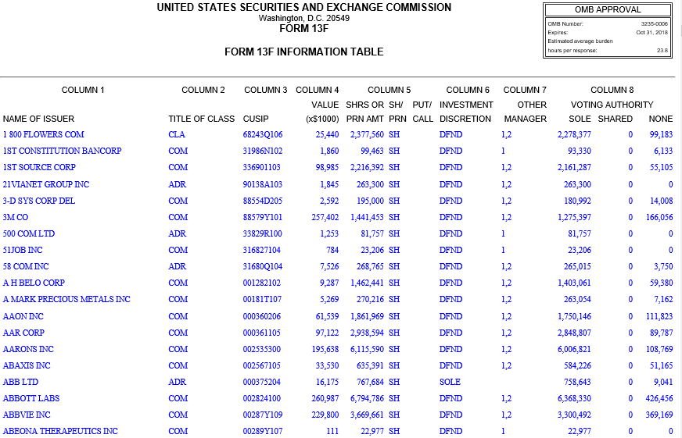
13F Disclosure

Slide 40
13F Disclosure
Notice that the disclosure includes the number of shares and market value of each security as of the period end date.
By comparing this period’s disclosure with the same fund manager’s disclosure last quarter, we can identify the net change in position for each listed security.

Slide 41
13F Disclosure
Limitations
By the time the disclosures are released, the portfolio holdings are stale.
Remember, institutional investors have up to 45 days after the quarter end to file their 13F. So, it is entirely possible that the fund completely turned over their portfolio during that time, leaving the 13F behind as an artifact of the distant past. On the other hand, for those investors that are known as having a long-term buy-and-hold investment philosophy, the 13F filing is likely to be a close approximation of the fund’s current portfolio holdings.
13F filings lack data pertaining to intra-period movements.
As noted above, by comparing quarter-over-quarter 13F filings, we can determine net position changes, but we cannot determine when trades actually occurred; whether the fund held a particular security throughout the quarter or simply purchased shares on the disclosure date (window-dressing); or if other securities were purchased and sold during the quarter. The lack of transactional data severely limits interested users’ ability to reverse engineer a fund’s trading strategy.
Institutional investors are only required to list long positions in certain securities.
While the security list is rather long, the omission of short positions and option positions makes it virtually impossible to accurately reconstruct an investors’ entire portfolio. Worse yet, the visually available long position listed in a 13F filing may actually be a hedge against another short position, leaving the user to wonder whether the investment manager is really bullish on a particular stock.

Slide 42
Transaction Analysis

Slide 43
Example Transactions
EDLC incurred the following transactions.
Purchased food, beverage, and packaging supplies costing $369,800, paying $289,800 in cash and owing the rest on account
At the beginning of January, paid $79,700 cash in advance for prepaid expenses for rent, insurance, and advertising
During the first quarter, sold food to customers for $1,071,700; $25,700 was sold to universities on account (to be paid by the universities next quarter), and the rest was received in cash in the stores. NOTE: To measure revenues and expenses in a period, begin with a $0 balance
Paid $40,800 for management training expenses
Paid employees $177,000 for work this quarter and $73,900 for work last quarter (recorded last quarter as Wages Expense and Wages Payable)
Sold for cash land costing $9,000 at a loss of $4,200
Received $39,000 cash from customers paying on their accounts

Slide 44
Example Transactions (cont.)
EDLC incurred the following transactions.
During the quarter, paid suppliers $73,500 on accounts payable. Also paid $35,900 on utilities payable and $28,400 in income taxes incurred for part of the first quarter of 2015
Paid $75,400 for utilities used during the quarter and paid $18,700 for repairs and maintenance of its facilities and equipment during the quarter
Received $1,200 cash as interest revenue earned during the quarter
During the quarter, sold gift cards to customers for $21,900 in cash (expected to be redeemed for food next quarter)

Slide 45
Transaction Analysis
EDLC incurred the following transactions.
Purchased food, beverage, and packaging supplies costing $369,800, paying $289,800 in cash and owing the rest on account
 |  | Debit | Credit
(1) | Supplies (+A) | 369,800
 | Cash (-A) |  | 289,800
 | Accounts Payable (+L) |  | 80,000
Cash (A)
BB | $ 323,200 | $
 |  | 289,800 | (1)
Supplies (A)
BB | $ 15,300 | $
(1) | 369,800
Accounts Payable (L)
 | $ | $ 69,600 | BB
 |  | 80,000 | (1)

Slide 46
Transaction Analysis
EDLC incurred the following transactions.
At the beginning of January, paid $79,700 cash in advance for prepaid expenses for rent, insurance, and advertising
 |  | Debit | Credit
(2) | Prepaid Expenses (+A) | 79,700
 | Cash (-A) |  | 79,700
Cash (A)
BB | $ 323,200 | $
 |  | 289,800 | (1)
 |  | 79,700 | (2)
Prepaid Expenses (A)
BB | $ 70,300 | $
(2) | 79,700

Slide 47
Transaction Analysis
EDLC incurred the following transactions.
During the first quarter, sold food to customers for $1,071,700; $25,700 was sold to universities on account (to be paid by the universities next quarter), and the rest was received in cash in the stores. NOTE: To measure revenues and expenses in a period, begin with a $0 balance
 |  | Debit | Credit
(3) | Cash (+A) | 1,046,000
 | Accounts Receivable (+A) | 25,700
 | Sales Revenue (+R; +SE) |  | 1,071,700
Cash (A)
BB | $ 323,200 | $
(3) | 1,046,000 | 289,800 | (1)
 |  | 79,700 | (2)
Accounts Receivable (A)
BB | $ 34,800 | $
(3) | 25,700
Sales Revenue (R)
 | $ | $ 0 | BB
 |  | 1,071,700 | (3)

Slide 48
Transaction Analysis
EDLC incurred the following transactions.
Paid $40,800 for management training expenses
 |  | Debit | Credit
(4) | Training Expense (+E; -SE) | 40,800
 | Cash (-A) |  | 40,800
Cash (A)
BB | $ 323,200 | $
(3) | 1,046,000 | 289,800 | (1)
 |  | 79,700 | (2)
 |  | 40,800 | (4)
Training Expense (E)
BB | $ 0 | $
(4) | 40,800

Slide 49
Transaction Analysis
EDLC incurred the following transactions.
Paid employees $177,000 for work this quarter and $73,900 for work last quarter (recorded last quarter as Wages Expense and Wages Payable)
 |  | Debit | Credit
(5) | Wages Expense (+E; -SE) | 177,000
 | Wages Payable (-L) | 73,900
 | Cash (-A) |  | 250,900
Cash (A)
BB | $ 323,200 | $
(3) | 1,046,000 | 289,800 | (1)
 |  | 79,700 | (2)
 |  | 40,800 | (4)
 |  | 250,900 | (5)
Wages Payable (L)
 | $ | $ 73,900 | BB
(5) | 73,900
Wages Expense (E)
BB | $ 0 | $
(5) | 177,000

Slide 50
Transaction Analysis
EDLC incurred the following transactions.
Sold for cash land costing $9,000 at a loss of $4,200
 |  | Debit | Credit
(6) | Cash (+A) | 4,800
 | Loss on Asset Disposal (+E; -SE) | 4,200
 | Land (-A) |  | 9,000
Cash (A)
BB | $ 323,200 | $
(3) | 1,046,000 | 289,800 | (1)
(6) | 4,800 | 79,700 | (2)
 |  | 40,800 | (4)
 |  | 250,900 | (5)
Land (A)
BB | $ 21,100 | $
 |  | 9,000 | (6)
Loss on Asset Disposal (E)
BB | $ 0 | $
(6) | 4,200

Slide 51
Transaction Analysis
EDLC incurred the following transactions.
Received $39,000 cash from customers paying on their accounts
 |  | Debit | Credit
(7) | Cash (+A) | 39,000
 | Accounts Receivable (-A) |  | 39,000
Cash (A)
BB | $ 323,200 | $
(3) | 1,046,000 | 289,800 | (1)
(6) | 4,800 | 79,700 | (2)
(7) | 39,000 | 40,800 | (4)
 |  | 250,900 | (5)
Accounts Receivable (A)
BB | $ 34,800 | $
(3) | 25,700 | 39,000 | (7)

Slide 52
Transaction Analysis
EDLC incurred the following transactions.
During the quarter, paid suppliers $73,500 on accounts payable. Also paid $35,900 on utilities payable and $28,400 in income taxes incurred for part of the first quarter of 2015
 |  | Debit | Credit
(8) | Accounts Payable (-L) | 73,500
 | Utilities Payable (-L) | 35,900
 | Income Tax Expense (+E; -SE) | 28,400
 | Cash (-A) |  | 137,800
Cash (A)
BB | $ 323,200 | $
(3) | 1,046,000 | 289,800 | (1)
(6) | 4,800 | 79,700 | (2)
(7) | 39,000 | 40,800 | (4)
 |  | 250,900 | (5)
 |  | 137,800 | (8)
Accounts Payable (L)
 | $ | $ 69,600 | BB
(8) | 73,500 | 80,000 | (1)
Income Tax Expense (E)
BB | $ 0 | $
(8) | 28,400
Utilities Payable (L)
 | $ | $ 85,400 | BB
(8) | 35,900

Slide 53
Transaction Analysis
EDLC incurred the following transactions.
Paid $75,400 for utilities used during the quarter and paid $18,700 for repairs and maintenance of its facilities and equipment during the quarter
 |  | Debit | Credit
(9) | Utilities Expense (+E; -SE) | 75,400
 | Maintenance Expense (+E; -SE) | 18,700
 | Cash (-A) |  | 94,100
Cash (A)
BB | $ 323,200 | $
(3) | 1,046,000 | 289,800 | (1)
(6) | 4,800 | 79,700 | (2)
(7) | 39,000 | 40,800 | (4)
 |  | 250,900 | (5)
 |  | 137,800 | (8)
 |  | 94,100 | (9)
Utilities Expense (E)
BB | $ 0 | $
(9) | 75,400
Maintenance Expense (E)
BB | $ 0 | $
(9) | 18,700

Slide 54
Transaction Analysis
EDLC incurred the following transactions.
Received $1,200 cash as interest revenue earned during the quarter
 |  | Debit | Credit
(10) | Cash (+A) | 1,200
 | Interest Revenue (+R; +SE) |  | 1,200
Cash (A)
BB | $ 323,200 | $
(3) | 1,046,000 | 289,800 | (1)
(6) | 4,800 | 79,700 | (2)
(7) | 39,000 | 40,800 | (4)
(10) | 1,200 | 250,900 | (5)
 |  | 137,800 | (8)
 |  | 94,100 | (9)
Interest Revenue (R)
 | $ | $ 0 | BB
 |  | 1,200 | (10)

Slide 55
Transaction Analysis
EDLC incurred the following transactions.
During the quarter, sold gift cards to customers for $21,900 in cash (expected to be redeemed for food next quarter)
 |  | Debit | Credit
(11) | Cash (+A) | 21,900
 | Unearned Revenue (+R) |  | 21,900
Cash (A)
BB | $ 323,200 | $
(3) | 1,046,000 | 289,800 | (1)
(6) | 4,800 | 79,700 | (2)
(7) | 39,000 | 40,800 | (4)
(10) | 1,200 | 250,900 | (5)
(11) | 21,900 | 137,800 | (8)
 |  | 94,100 | (9)
Unearned Revenue (L)
 | $ | $ 16,800 | BB
 |  | 21,900 | (11)

Slide 56
Transaction Analysis
Ending Balance Sheet Accounts:
Cash (A)
BB | $ 323,200 | $
(3) | 1,046,000 | 289,800 | (1)
(6) | 4,800 | 79,700 | (2)
(7) | 39,000 | 40,800 | (4)
(10) | 1,200 | 250,900 | (5)
(11) | 21,900 | 137,800 | (8)
 |  | 94,100 | (9)
 | 543,000
Accounts Receivable (A)
BB | $ 34,800 | $
(3) | 25,700 | 39,000 | (7)
 | 21,500
Prepaid Expenses (A)
BB | $ 70,300 | $
(2) | 79,700
 | 150,000
Supplies (A)
BB | $ 15,300 | $
(1) | 369,800
 | 385,100
Land (A)
BB | $ 21,100 | $
 |  | 9,000 | (6)
 | 12,100
Accounts Payable (L)
 | $ | $ 69,600 | BB
(8) | 73,500 | 80,000 | (1)
 |  | 76,100
Wages Payable (L)
 | $ | $ 73,900 | BB
(5) | 73,900
 |  | 0
Unearned Revenue (L)
 | $ | $ 16,800 | BB
 |  | 21,900 | (11)
 |  | 38,700
Utilities Payable (L)
 | $ | $ 85,400 | BB
(8) | 35,900
 |  | 49,500

Slide 57
Transaction Analysis
Ending Income Statement Accounts:
Sales Revenue (R)
 | $ | $ 0 | BB
 |  | 1,071,700 | (3)
 |  | 1,071,700
Maintenance Expense (E)
BB | $ 0 | $
(9) | 18,700
 | 18,700
Training Expense (E)
BB | $ 0 | $
(4) | 40,800
 | 40,800
Interest Revenue (R)
 | $ | $ 0 | BB
 |  | 1,200 | (10)
 |  | 1,200
Utilities Expense (E)
BB | $ 0 | $
(9) | 75,400
 | 75,400
Loss on Asset Disposal (E)
BB | $ 0 | $
(6) | 4,200
 | 4,200
Wages Expense (E)
BB | $ 0 | $
(5) | 177,000
 | 177,000
Income Tax Expense (E)
BB | $ 0 | $
(8) | 28,400
 | 28,400

Slide 58
Trial Balance

Slide 59
Unadjusted Trial Trial Balance
Before creating any statements, we must first create an unadjusted trial balance for the company’s accounts. Although debits and credits match, this is an unadjusted trial balance because we have not completed the end-of-period adjusting entries yet.
 | Debit | Credit
Cash | 543,000
Short-term Investments | 347,600
Accounts Receivable | 21,500
Supplies | 385,100
Prepaid Expenses | 150,000
Land | 12,100
Buildings | 1,275,300
Equipment | 476,300
Accumulated Depreciation |  | 613,700
Long-term Investments | 531,100
Intangible Assets | 68,400
Accounts Payable |  | 76,100
Unearned Revenue |  | 38,700
Dividends Payable |  | 3,000
Utilities Payable |  | 49,500
Notes Payable |  | 2,000
Other Liabilities |  | 285,900
Common Stock |  | 500
Additional Paid-in-Capital |  | 293,800
Retained Earnings |  | 1,718,800
Sales Revenue |  | 1,071,700
Interest Revenue |  | 1,200
Wages Expense | 177,000
Utilities Expense | 75,400
Repairs Expense | 18,700
Training Expense | 40,800
Loss on Disposal of Assets | 4,200
Income Tax Expense | 28,400
Total | 4,154,900 | 4,154,900

Slide 60
Classified Income Statement
This classified income statement is organized into operating activities and peripheral activities. However, note that the numbers are unadjusted and would not be presented to external users.
Consolidated Statement of Income
Unadjusted
For the Quarter Ended June 30, 2017
(in thousands of dollars)
Sales Revenue | $1,071,700
Operating Expenses:
Wages Expense | 177,000
Utilities Expense | 75,400
Repairs Expense | 18,700
General and Administrative Expenses:
Training Expense | 40,800
Loss on Disposal of Asset | 4,200
Total Operating Expenses | 316,100
Income from Operations | 755,600
Other Items:
Interest Revenue | 1,200
Income Before Income Taxes | 756,800
Income Tax Expense | 28,400
Net Income | $ 728,400

Slide 61
Net Profit Margin

Slide 62
Net Profit Margin
How effective is management in generating profit on every dollar of sales?
Net profit margin measures how much every sales dollar generated during the period affects profit. A rising net profit margin signals more efficient management of sales and expenses.
Net Income
Net Sales (or Operating Revenues)
Net Profit Margin
=

Slide 63

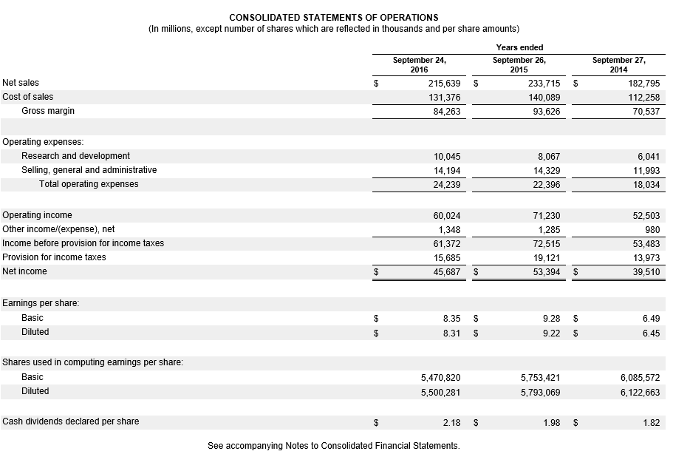
Net Profit Margin

Slide 64
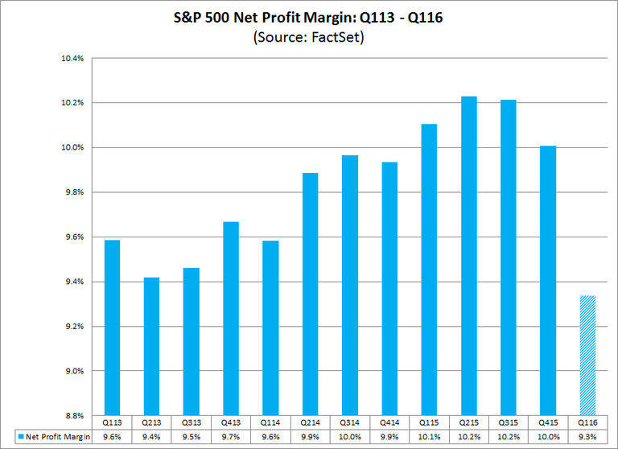
Net Profit Margin

Slide 65
Net Profit Margin

Slide 66
Net Profit Margin

Slide 67
Statement of Cash Flows

Slide 68
Statement of Cash Flows
Companies report cash inflows and outflows in their statement of cash flows:
Operating activities
Change in Accounts Receivable
Change in Inventory
Change in Prepaid Expenses
Change in Current Liabilities
Change in Accounts Payable
Change in Wages Payable
Change in Unearned Revenue
Investing activities (covered in Chapter 2)
Financing activities (covered in Chapter 2)

Slide 69
End of Chapter 03

